Slide 1
Scenarios

Slide 2
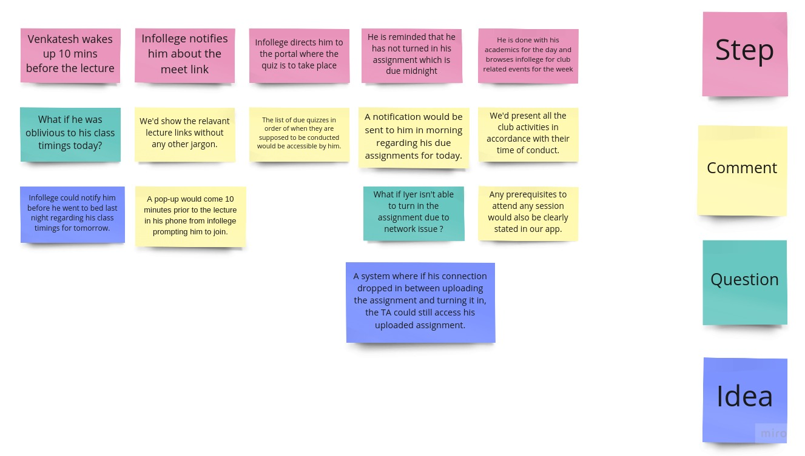

Slide 3
Low-Fidelity Prototype

Slide 4
